Slide 1
Mechanisms and Robotics DE ES DM ZG561
Lecture - 4

Slide 2
Fundamentals of Robot Technology
Kinematic Synthesis of Mechanisms
The form or type synthesis
The number synthesis
The dimensional synthesis
Synthesis of a 4 bar mechanism
Numerical Example

Slide 3
Kinematic Synthesis
Kinematics is the study of the motion of mechanisms and methods of creating them.
Kinematic synthesis may be treated as a reverse problem of kinematic analysis and aims at designing a mechanism which can satisfy prescribed motion characteristics, such as displacement, velocity and acceleration.
Synthesis is accomplished in three interrelated phases
The form or type synthesis
The number synthesis
The dimensional synthesis

Slide 4
Kinematic Synthesis
Form or Type Synthesis
This refers to the kind of mechanism selected, like a belt drive, gear drive, linkage or cam mechanism.
Number Synthesis
Number synthesis is based on the most obvious external characteristics of a kinematic chain, namely the number of links together with the number of joints along with the joint type.
Dimensional synthesis
Dimensional synthesis aims at determining significant dimensions of the links and starting position of links in a mechanism, to accomplish specified task and prescribed motion characteristics.

Slide 5
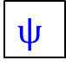
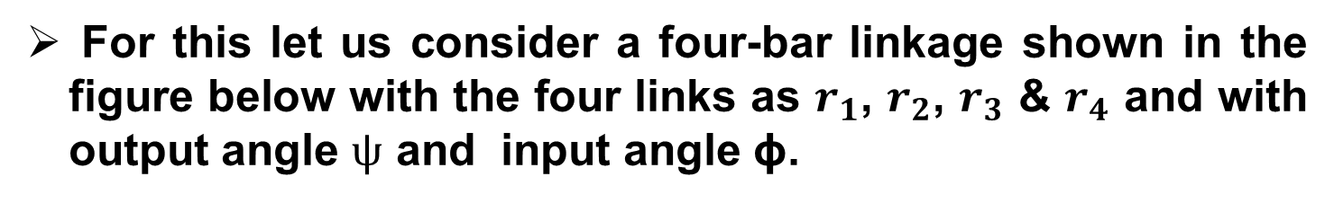
Algebraic Method of Kinematic Synthesis
For this let us consider a four-bar linkage shown in the figure below with the four links as $r_{1}$, $r_{2}$, $r_{3}$ & $r_{4}$ and with output angle $ψ$ and input angle $\text{ϕ}$.
B
Y
r₂
r₃
A
r₁
$$ψ$$
ϕ
C
X
r₀
O

Slide 7
Algebraic Method of Kinematic Synthesis
For this let us consider a four-bar linkage shown in the figure below with the four links as $r_{1}$, $r_{2}$, $r_{3}$ & $r_{4}$ and with output angle $ψ$ and input angle $\text{ϕ}$.
B
Y
r₂
r₃
A
r₁
$$ψ$$
ϕ
C
X
r₀
O

Slide 8
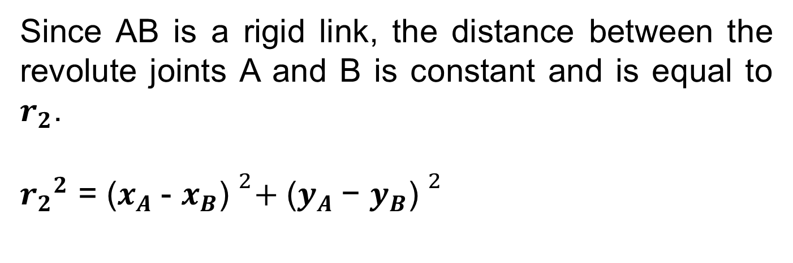
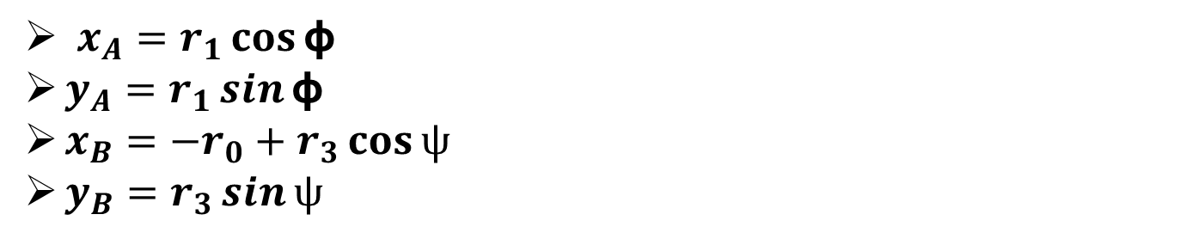
Algebraic Method of Kinematic Synthesis
$x_{A}=r_{1}\cos{\text{ϕ} }$
$y_{A}=r_{1}\sin{\text{ϕ} }$
$x_{B}=−{r_{0}+r}_{3}\cos{ψ }$
$y_{B}=r_{3}\sin{ψ}$
Since AB is a rigid link, the distance between the revolute joints A and B is constant and is equal to $r_{2}$.
${r_{2}}^{2}$ = ${\text{(}x_{A} \text{− }x_{B}\text{) }}^{2}+ {\text{(}y_{A} \text{− }y_{B}\text{) }}^{2}$

Slide 9
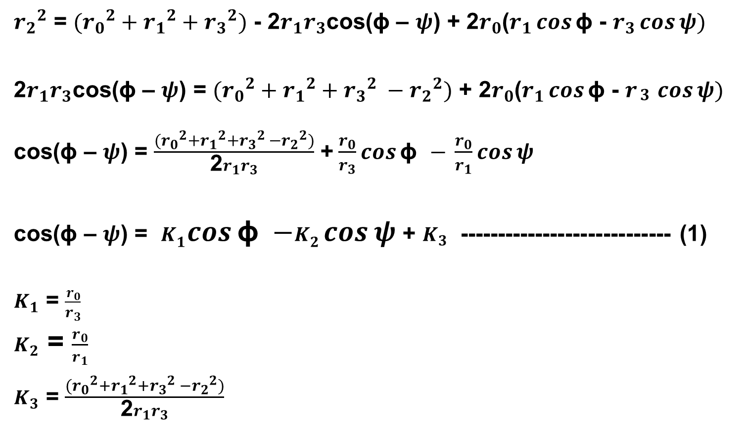
Algebraic Method of Kinematic Synthesis
${r_{2}}^{2}$ = $({r_{0}}^{2}+{r_{1}}^{2}+{r_{3}}^{2})$ - 2$r_{1}r_{3}$cos(ϕ – $ψ$) + 2$r_{0}$($r_{1}\cos{\text{ϕ} }$- $r_{3}\cos{ψ)}$
2$r_{1}r_{3}$cos(ϕ – $ψ$) = $({r_{0}}^{2}+{r_{1}}^{2}+{r_{3}}^{2} −{r_{2}}^{2})$ + 2$r_{0}$($r_{1}\cos{\text{ϕ} }$- $r_{\begin{aligned}3 \\ \end{aligned}}\cos{ψ)}$
cos(ϕ – $ψ$) = $\frac{({r_{0}}^{2}+{r_{1}}^{2}+{r_{3}}^{2} −{r_{2}}^{2})}{\text{2}r_{1}r_{3}}$ +$\frac{r_{0}}{r_{3}}cos{\text{ϕ} }$ $− \frac{r_{0}}{r_{1}}\cos{ψ}$
cos(ϕ – $ψ$) = $K_{1}cos{\text{ϕ} }$ $−K_{2}\cos{ψ}$ + $K_{3}$ ---------------------------- (1)
$K_{1}$ = $\frac{r_{0}}{r_{3}}$
$K_{2}$ = $\frac{r_{0}}{r_{1}}$
$K_{3}$ = $\frac{({r_{0}}^{2}+{r_{1}}^{2}+{r_{3}}^{2} −{r_{2}}^{2})}{\text{2}r_{1}r_{3}}$
Equation (1) is called Freudenstein’s equation and can be used for synthesis of a 4 bar mechanism..

Slide 10
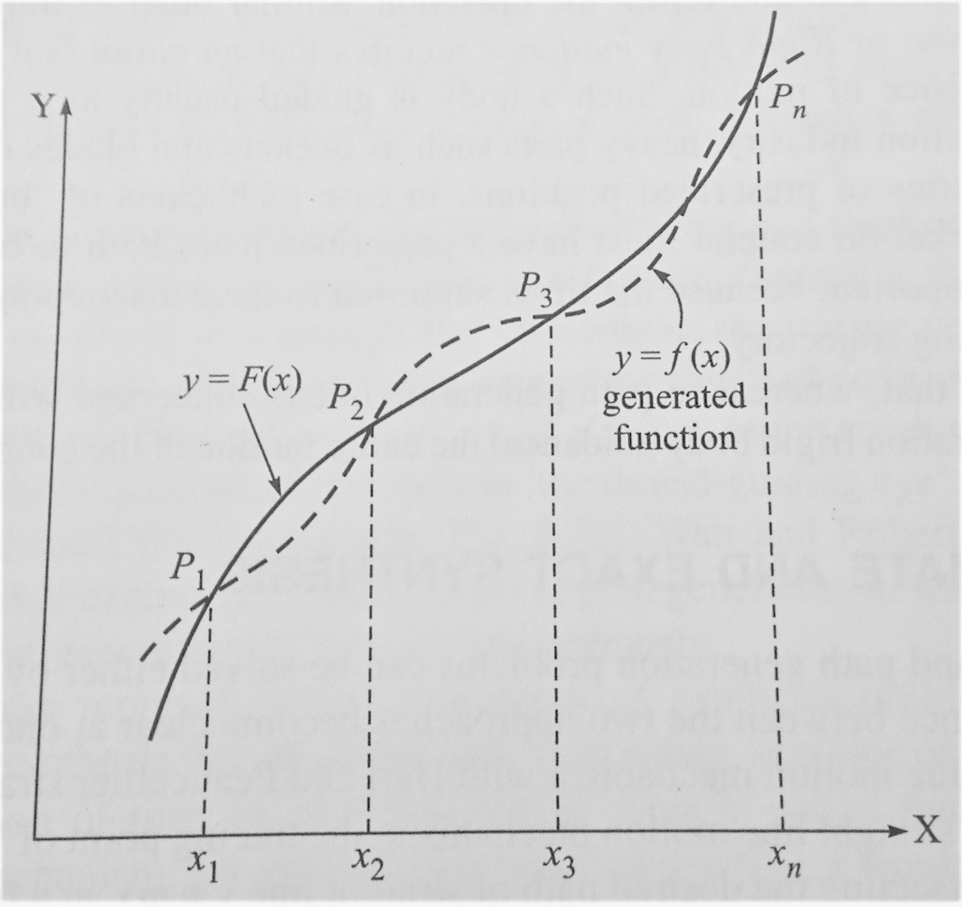
Approximate and Exact Synthesis
If the required link follows the exact curve specified, the synthesis is called exact synthesis.
If the link meets the exact path at only a few points it is approximate synthesis.
The difference between the two functions (exact and approximate) is called structural error.

Slide 11
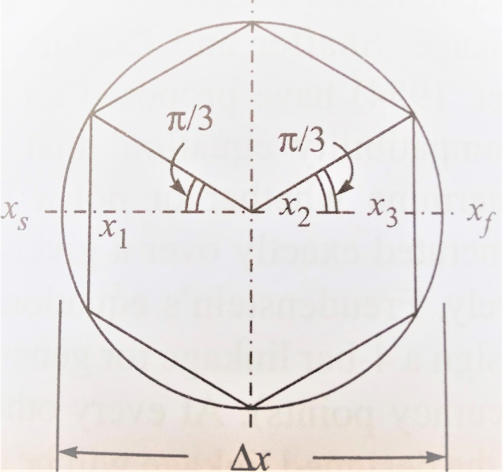
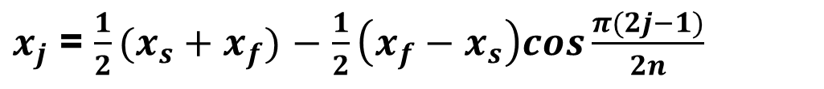
Chebyshev’s Spacing of accuracy points
$x_{j}$ = $\frac{1}{2}(x_{s}+x_{f})$ $−$ $\frac{1}{2}\left(x_{f}{− x}_{s}\right)cos\frac{π(2j−1)}{2n}$
When the mechanism is designed to generate a specified function or trace a given curve over a given range, the function is exactly generated at a finite number of points.
These are known as accuracy points obtained by using the above formula.
It is also the same as drawing a circle with a diameter equal to the range of the function
The next step is to inscribe in it a regular polygon of sides 2n
The polygon must be inscribed such that at least two sides are perpendicular to the x axis.

Slide 12
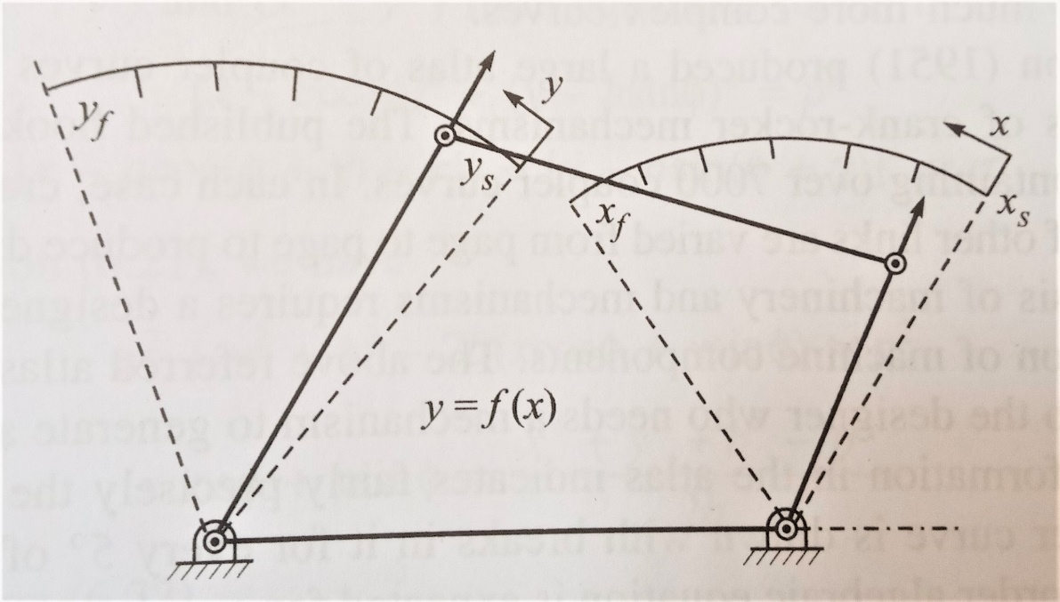
Function Generator
Function generator is a device for indicating corresponding values of x and y.

Slide 13
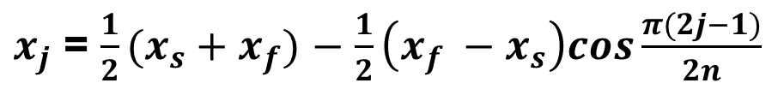
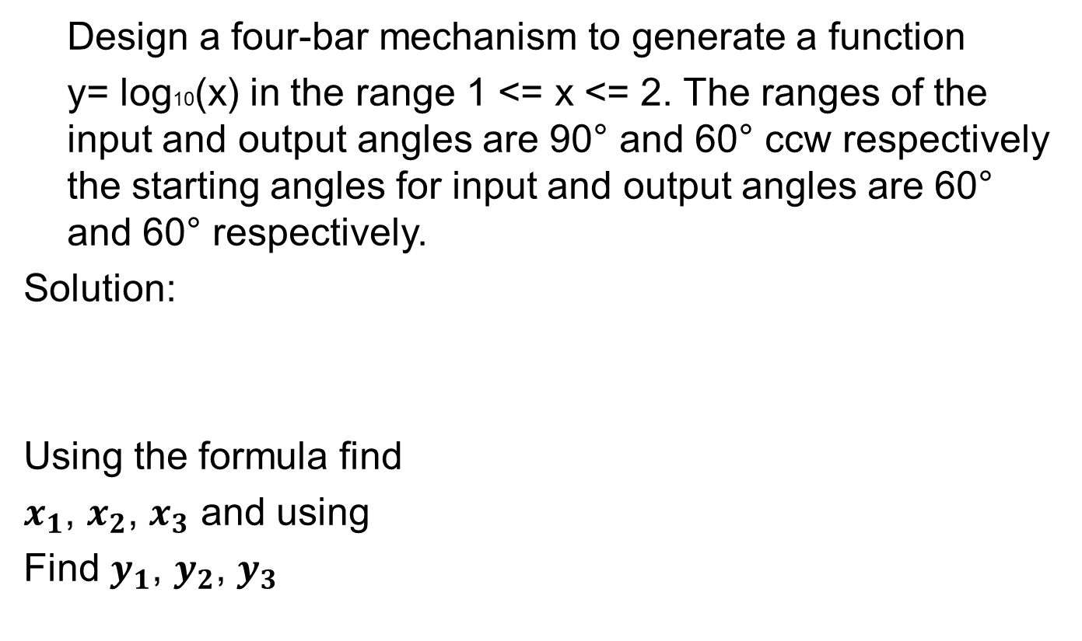
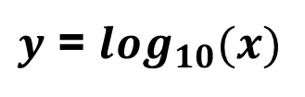
Numerical Example
Design a four-bar mechanism to generate a function
y= log10(x) in the range 1 <= x <= 2. The ranges of the input and output angles are 90° and 60° ccw respectively the starting angles for input and output angles are 60° and 60° respectively.
Solution:
Using the formula find
$x_{1}$, $x_{2}$, $x_{3}$ and using
Find $y_{1}$, $y_{2}$, $y_{3}$
$x_{j}$ = $\frac{1}{2}(x_{s}+x_{f})$ $−$ $\frac{1}{2}\left(x_{f} −x_{s}\right)cos\frac{π(2j−1)}{2n}$
$y$ = $\log_{10}(x)$

Slide 14
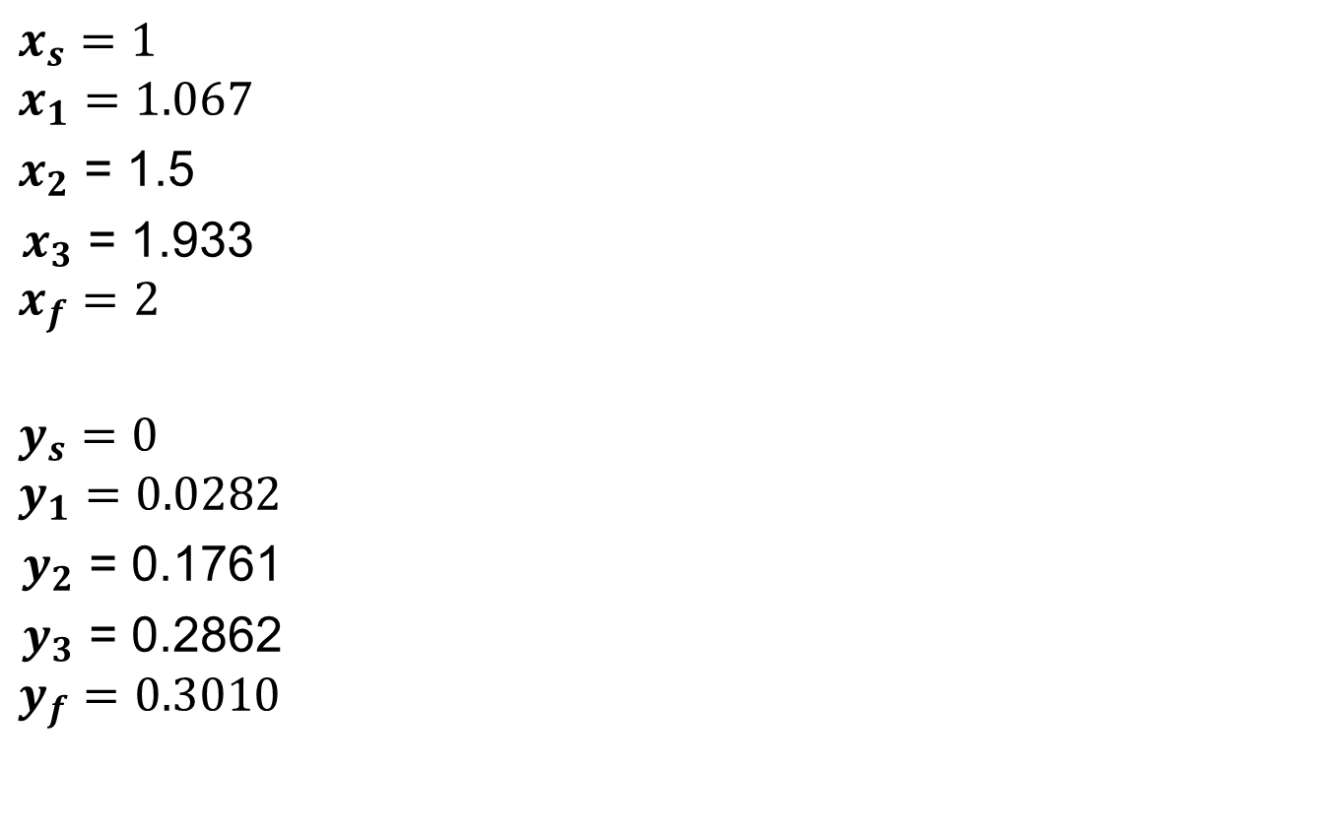
Solution
$$x_{s}=1$$
$$x_{1}=1.067$$
$x_{2}$ = 1.5
$x_{3}$ = 1.933
$$x_{f}=2$$
$$y_{s}=0$$
$$y_{1}=0.0282$$
$y_{2}$ = 0.1761
$y_{3}$ = 0.2862
$$y_{f}=0.3010$$

Slide 15
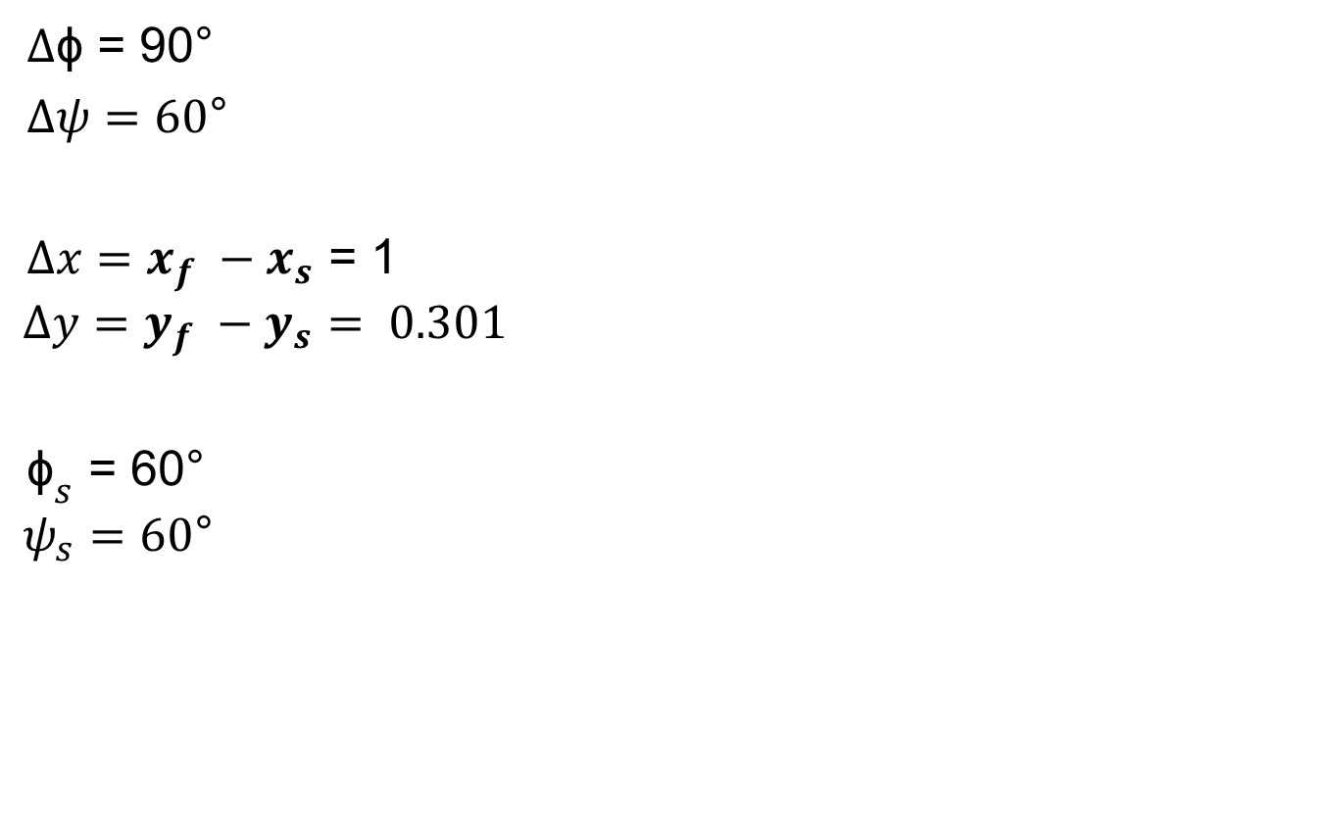
Solution
$∆\text{ϕ}$ = 90°
$∆ψ=60$°
$∆x=x_{f} −x_{s}$ = 1
$$∆y=y_{f} −y_{s}= 0.301$$
${\text{ϕ}}_{s}$ = 60°
$$ψ_{s}=60\text{°}$$

Slide 16
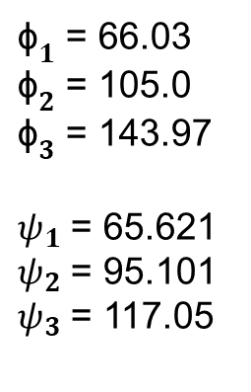
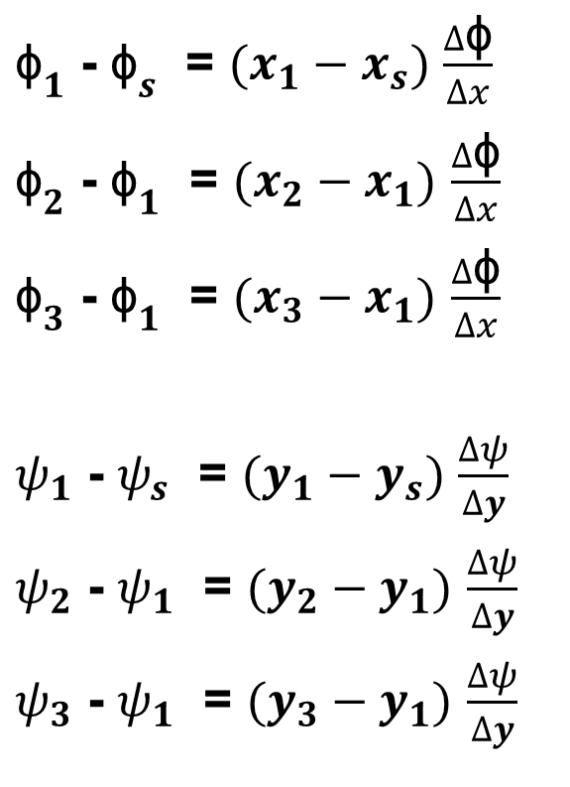
Solution
${\text{ϕ}}_{1}$ - ${\text{ϕ}}_{s}$ = $(x_{1}−x_{s})$ $\frac{∆\text{ϕ}}{∆x}$
${\text{ϕ}}_{2}$ - ${\text{ϕ}}_{1}$ = $(x_{2}−x_{1})$ $\frac{∆\text{ϕ}}{∆x}$
${\text{ϕ}}_{3}$ - ${\text{ϕ}}_{1}$ = $(x_{3}−x_{1})$ $\frac{∆\text{ϕ}}{∆x}$
$ψ_{1}$ - $ψ_{s}$ = $(y_{1}−y_{s})$ $\frac{∆ψ}{∆y}$
$ψ_{2}$ - $ψ_{1}$ = $(y_{2}−y_{1})$ $\frac{∆ψ}{∆y}$
$ψ_{3}$ - $ψ_{1}$ = $(y_{3}−y_{1})$ $\frac{∆ψ}{∆y}$
${\text{ϕ}}_{1}$ = 66.03
${\text{ϕ}}_{2}$ = 105.0
${\text{ϕ}}_{3}$ = 143.97
$ψ_{1}$ = 65.621
$ψ_{2}$ = 95.101
$ψ_{3}$ = 117.05

Slide 17
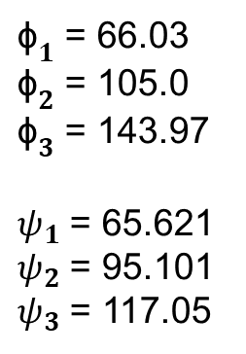
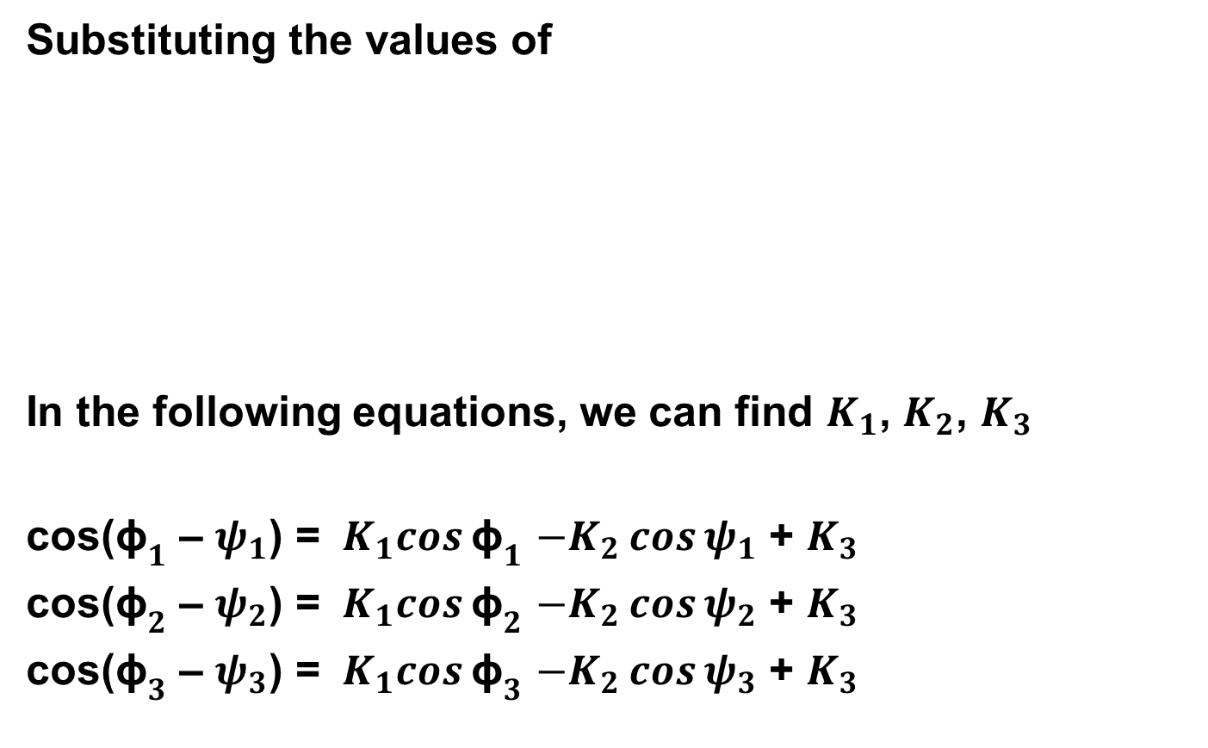
Solution
Substituting the values of
In the following equations, we can find $K_{1}$, $K_{2}$, $K_{3}$
cos(${\text{ϕ}}_{1}$ – $ψ_{1}$) = $K_{1}cos{{\text{ϕ}}_{1}}$ $−K_{2}\cos{ψ_{1}}$ + $K_{3}$
cos(${\text{ϕ}}_{2}$ – $ψ_{2}$) = $K_{1}cos{{\text{ϕ}}_{2}}$ $−K_{2}\cos{ψ_{2}}$ + $K_{3}$
cos(${\text{ϕ}}_{3}$ – $ψ_{3}$) = $K_{1}cos{{\text{ϕ}}_{3}}$ $−K_{2}\cos{ψ_{3}}$ + $K_{3}$
${\text{ϕ}}_{1}$ = 66.03
${\text{ϕ}}_{2}$ = 105.0
${\text{ϕ}}_{3}$ = 143.97
$ψ_{1}$ = 65.621
$ψ_{2}$ = 95.101
$ψ_{3}$ = 117.05

Slide 18
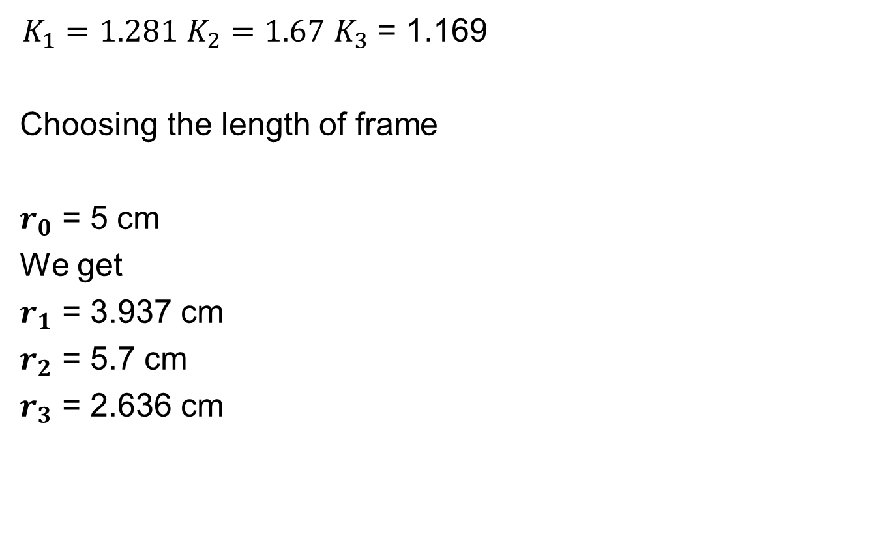
Solution
$K_{1}=1.281$ $K_{2}=1.67$ $K_{3}$ = 1.169
Choosing the length of frame
$r_{0}$ = 5 cm
We get
$r_{1}$ = 3.937 cm
$r_{2}$ = 5.7 cm
$r_{3}$ = 2.636 cm

Slide 19
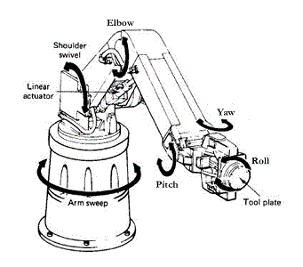
Robot Construction
A robot is mechanically constructed by connecting a set of bodies, called links, to each other using various types of joints.
Actuators, such as electric motors, deliver forces or torques to the joints that cause the robot’s links to move.

Slide 20
Robot Construction

Slide 21
Actuators
 | Pneumatic | Hydraulic | Electric
Working | Pressurized air, Nitrogen | Pressurized oil | Electricity
Input Power Supply | 35 – 3500 Kpa | 350 – 35000 Kpa | 24 – 440 Volts

Slide 22
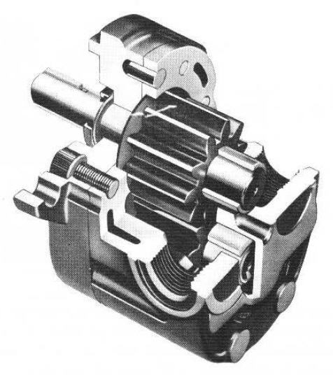
Hydraulic Systems – Pumps
External Gear Pump

Slide 23
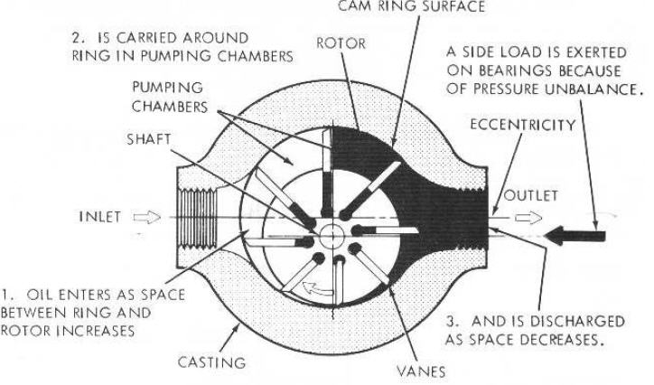
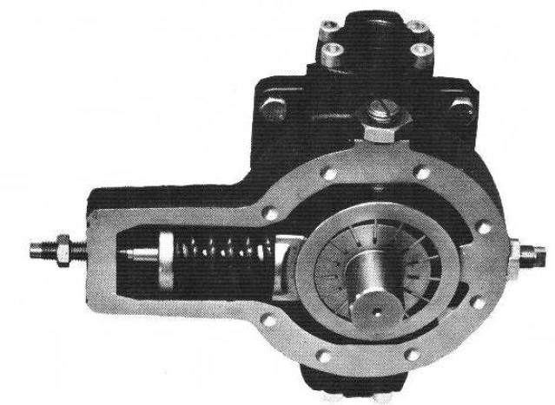
Vane Pump
Vane Pump

Slide 24
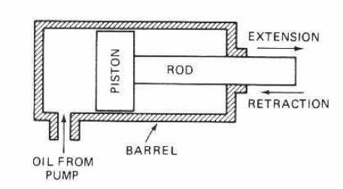
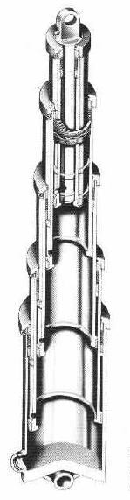
Fluid Power - Actuators
Piston Cylinder
Telescopic Cylinder

Slide 25
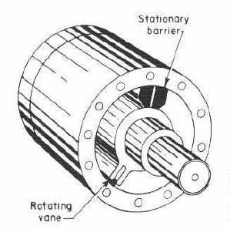
Actuators - Rotational
Limited Rotation Hydraulic Actuator

Slide 26
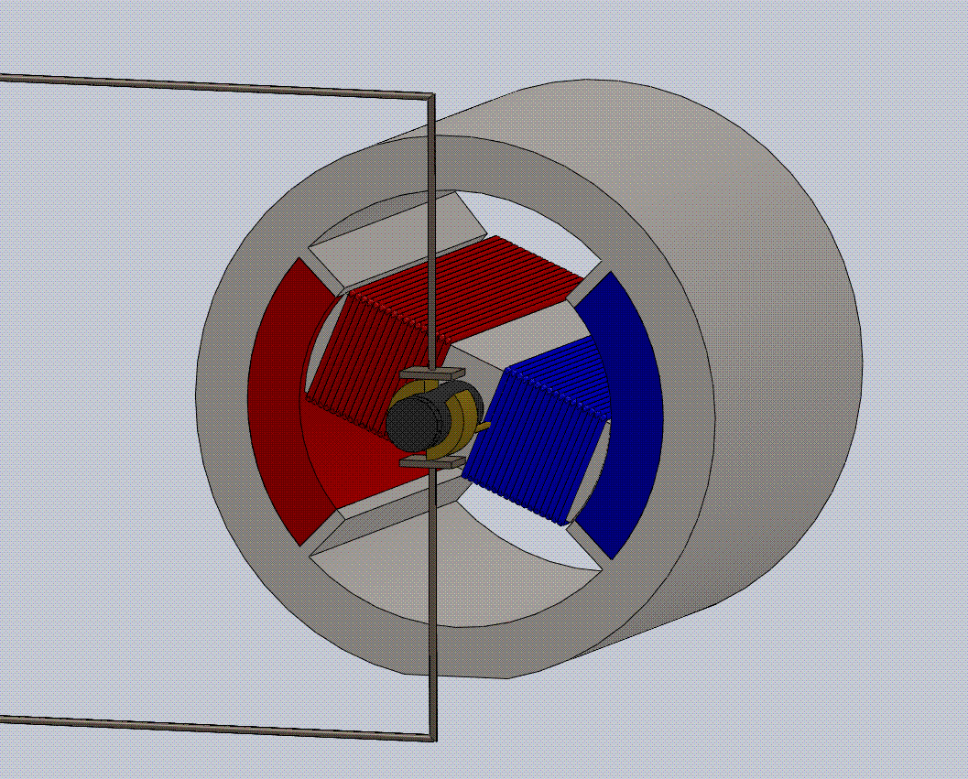
DC Motor
Working of a Permanent Magnet DC Motor

Slide 27
DC Servo Motors
DC Motors used in closed loop control are known as servo motors.
Servo motors can be brushed or brushless
Brushless motor → windings in stator
Brushed motor → windings in rotor
Servo motors are required to have very large acceleration and deceleration to have a faster response, the armatures of these motors are designed to have low inertia.

Slide 28
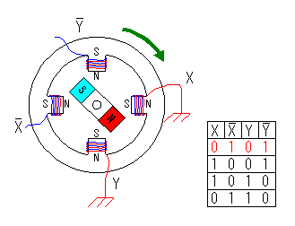
Stepper Motor – Permanent Magnet
Referred to as the “tin can” motor.
Has a permanent magnet rotor.

Slide 29
Power Transmission Systems
Gears
Power Screws
Ball Screws
Roller Screws
Belt Drives
Chain Drives
Harmonic Drives

Slide 30
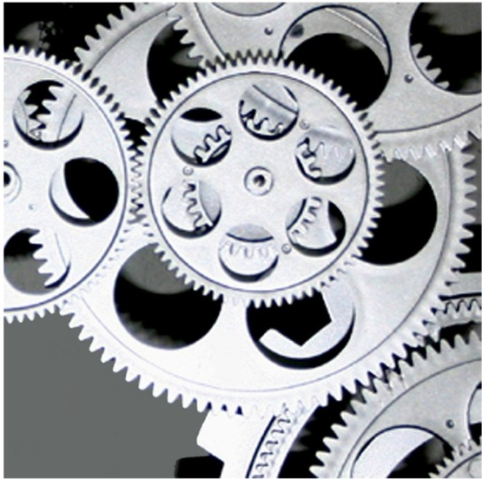
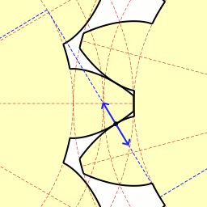
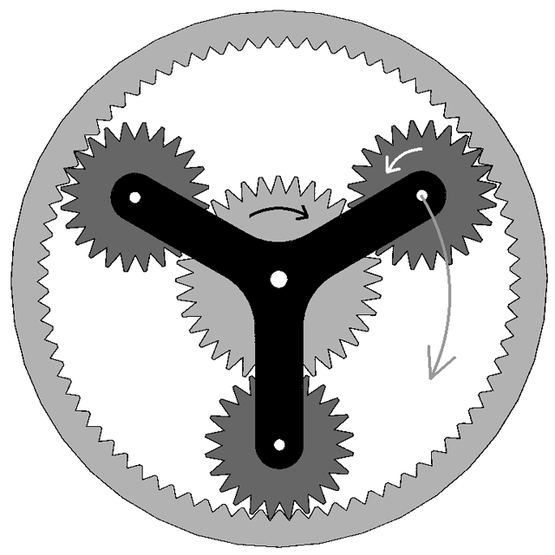
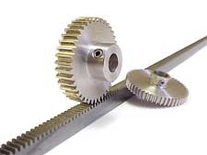
Gears

Slide 31
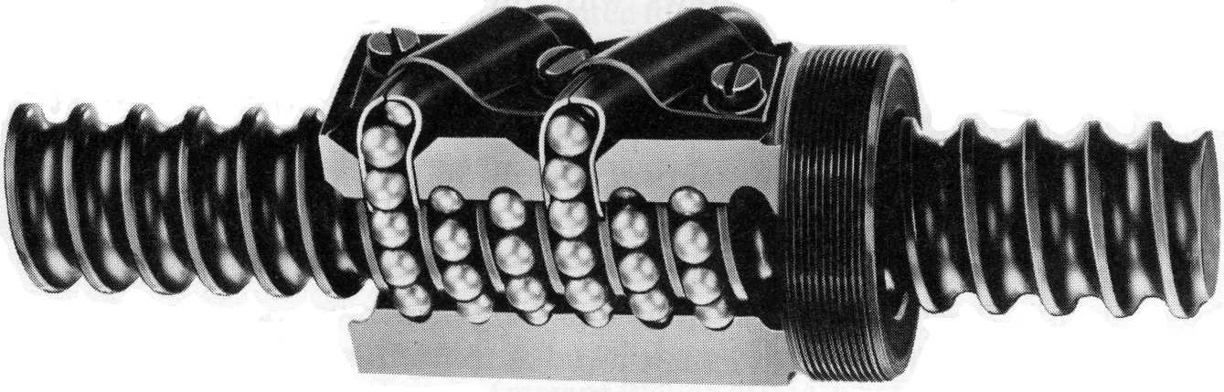
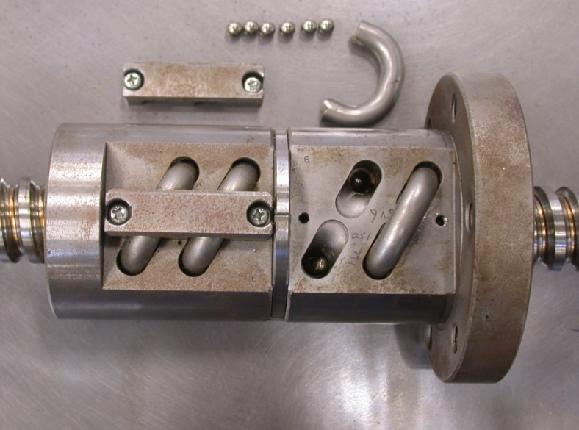
Power Screws
Re-circulating ball screw
Ball Screw

Slide 32
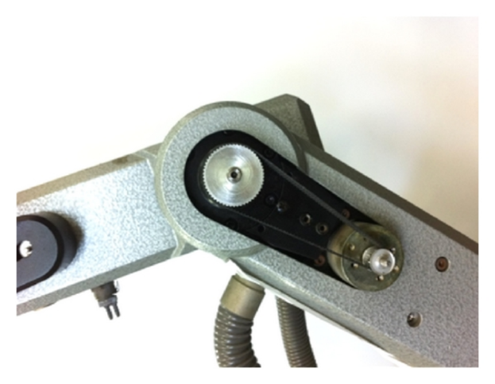
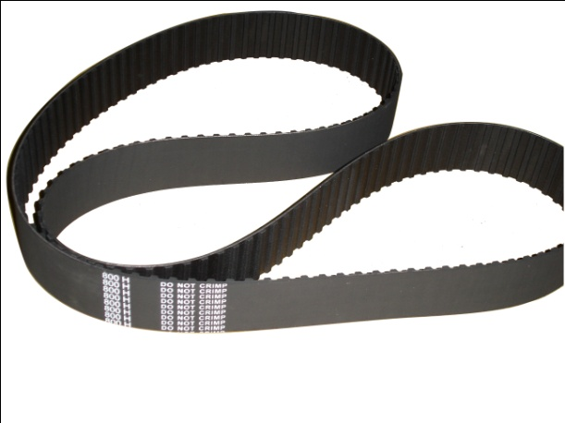
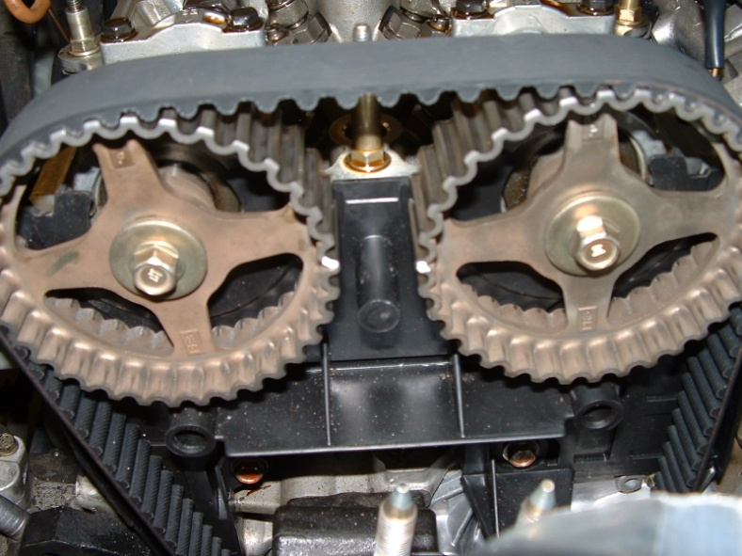
Belt Drives
Timing Belt
Timing Belt in an automobile engine

Slide 33
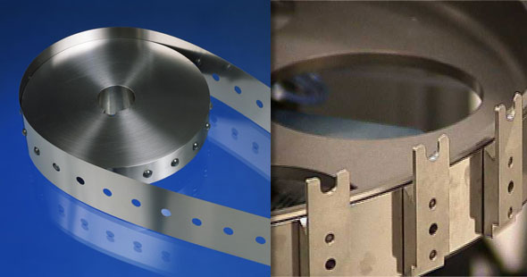
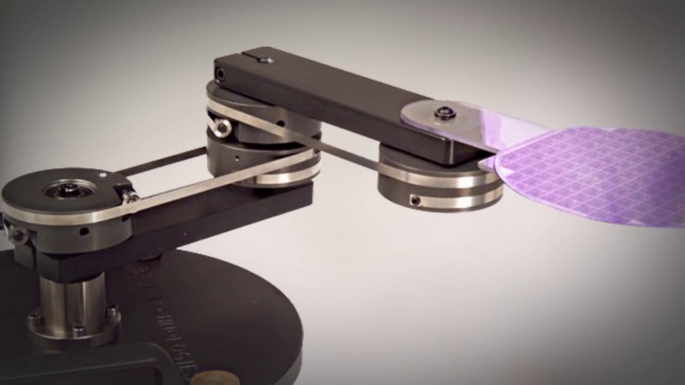
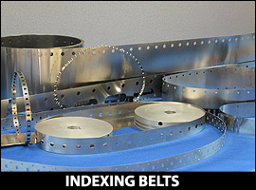
Metal Belts
Metal Belts in a Robot
Metal Belts provide positive displacement with minimum backlash
Image Source: https://www.belttechnologies.com

Slide 34
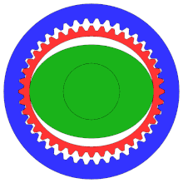
Harmonic Drive
Harmonic Drive
Image Source: Wikipedia

Slide 35
THANK YOU
The presenter is grateful to the authors of the following text books for their wonderful work.
Machines and Mechanisms, Applied Kinematic Analysis (Fourth Edition) – David H. Myszka
Industrial Robotics - Mikell P. Groover
Fundamentals of Robotics – Robert Schilling
Mechanism and Machine Theory, Ashok G. Ambekar

